Slide 1
Reward schemes in blockchain environments: Shapley value and proportional sharing
Vangelis Markakis
Athens University of Economics and Business (AUEB)
Archimedes, Athena Research Center,
Input Output Global (IOG)
Joint work with Aggelos Kiayias, Elias Koutsoupias, Panagiotis Tsamopoulos (appeared at AFT ’25)

Slide 2
Outline
Short intro to Proof of Stake blockchain protocols
Pool formation games and reward sharing schemes
Equilibrium analysis and comparisons between proportional sharing and Shapley value
Sybil resilience
Conclusions

Slide 3
Proof of Work vs Proof of Stake
Proof of Work protocols
rely on computational (hashing) power
Block producers need to solve some cryptographic puzzle by brute force
Very high energy consumption
Proof of Stake protocols: a different approach
Computationally hard work replaced by randomization
Much more energy efficient!
State of the system determined by the stake (amount of owned cryptocurrency) of each user
In operation since 2017

Slide 4
Proof of Stake protocols
How do they work:
Protocol run on a per epoch basis
6.5 mins in Ethereum, 5 days in Cardano
Each epoch split into slots
Registered validators: users who run a validating node
These are the users who can participate to produce and to validate blocks (and thus get rewards)
Epoch t-1
Epoch t
Genesis

Slide 5
Proof of Stake protocols
How do they work:
Stake vector of validators at the beginning of an epoch: (s₁,…, s_{n})
Randomization used to select a committee of validators in each epoch
Randomization also used to select a slot leader (or block proposer) for each time slot
Variations for the probability of selecting validator i:
monotonically dependent on s_{i}
Or equiprobable among all users with s_{i} ≥ h, for some threshold h
Epoch t-1
Epoch t
Genesis

Slide 6
Proof of Stake protocols
How do they work:
At a given slot
The slot leader proposes a new block of transactions to be added to the chain
The committee of validators vote on it
In some slots we may have no new blocks
The slot leader might be offline or out of sync
At the end of the epoch, rewards distributed to validators
block rewards + transaction fees
Epoch t-1
Epoch t
Genesis

Slide 7
Proof of Stake protocols
How does someone become a validator?
Needs only elementary technical knowledge
Installing and running a blockchain node
Usually a minimum amount of stake required to register
In Ethereum, threshold = 32ETH (currently ≈ 100K USD)
A stakeholder could register relying solely on her own stake
But they could also join forces with other stakeholders to form a pool
With one pool member acting as the actual validator
For the non-validators, quite popular choice as a “passive” way to earn more money, without worrying about setting up a validating node

Slide 8
Staking pools
Options for pooling:
Can be supported by the protocol – onchain pooling (e.g. Cardano)
Each stakeholder can decide if she wants to be a validator or delegate her stake to a particular pool
Or simply by offchain agreements among individuals – offchain pooling
Can also be supported by mediator platforms that facilitate grouping into pools via smart contracts (e.g. Rocketpool for Ethereum)

Slide 9
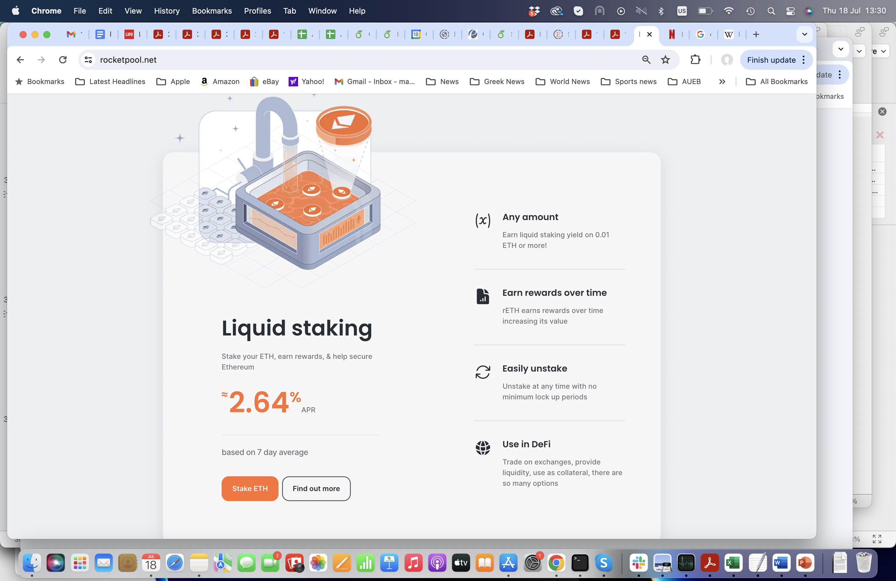
Staking pools
A platform for pooling:

Slide 10
Reward sharing among pool members
How should a pool split among its members the rewards it receives?
Regardless of whether we have onchain or offchain pooling
Most systems employ a proportional rule (according to stake owned)
Reward according to s_{i} / Σ_{j} s_{j}
After the validator claims her cost and profit margins
Is proportional sharing the best we can do?
We should first see what are the objectives we want to achieve

Slide 11
Relevant desiderata
Promoting decentralization
creation of a high number of pools very desirable
Even beyond the number of pools: geographic diversity/robustness, presence of operators from all continents
Sybil resistance
Discourage stakeholders to create multiple identities and split their stake into different pools
Fairness
Creation of pools with roughly equal size
Fair allocation of rewards to its members

Slide 12
Reward sharing among pool members
[Chen, Papadimitriou, Roughgarden ’19]:
A formal justification for the use of proportional sharing
Axiomatic study but for a model without pool formation
What else could we try out?
Almost anything from cooperative game theory!
Main objective in cooperative games: how to split rewards/costs so that formed coalitions are “stable”
But usually studied without the angle of decentralization or Sybil attacks

Slide 13
Solutions from cooperative games
The core [Gillies ’59]
Most studied solution in cooperative games
Informally: allocate rewards so that no subset of a pool has incentives to break away and form a pool on its own
A polyhedron of solutions (defined by linear inequalities)
Main drawback: The core is empty in several games
Too strict to satisfy all core constraints
Core emptiness already discussed in the context of blockchains in [Lewenberg et al. ’15]

Slide 14

Solutions from cooperative games
The Shapley value [Shapley ’53]
Proposed as a way to reward more the most pivotal players
Informally: what counts is the marginal contribution a player makes when added to a set; thus average out over all possible permutations of players
Formally: Shapley value for player i in pool S =
Recently proposed as a possible blockchain rewards sharing scheme [Chen et al. ’20]
But studied only w.r.t. its computational aspects

Slide 15
Shapley vs proportional sharing
Comparing reward schemes
We study a pool formation game
Set of players N
Each stakeholder chooses whether to open a pool or join someone else’s pool
Strategy space ≡ N
Comparison of Nash equilibria w.r.t. decentralization
Number of pools formed at equilibrium
Sybil resilience of equilibrium formations

Slide 16

Shapley vs proportional sharing
We have considered a model with
Small and large players
Oceanic games [Milnor, Shapley ’78]
Volume of infinitesimally small players (the ocean) and finite number of bigger players
Advocated for blockchain populations [Leonardos, Leonardos, Piliouras ’19]
We also have analogous results for a discrete version of this
Threshold-based pool rewards
Capturing Ethereum-like protocols
Pools are either winning (total stake at least h) or losing

Slide 17
Game-theoretic analysis
We focus on the case that s_{i} < h, for every atomic player i:
We are interested in players who need to collaborate with others in order to be part of a winning pool
Much larger players would most likely run their own pools of size ≈h
Definition: Given a reward scheme, a partition (C₁, C₂,…, C_{m}) is a Nash equilibrium if no player has a unilateral incentive to move her stake to another pool

Slide 18
Benchmark
Optimal decentralized formation:
OPT = maximum number of pools we can make with total stake at least h each
Known as the Dual Bin Packing problem (or Bin Cover)
Fact: The Price of Anarchy can be very large (Ω(OPT))
The grand coalition is an equilibrium
But a very unnatural one
We instead focus on the Price of Stability
For a game G, let W_{G} = maximum number of winning pools at an equilibrium of G
Price of Stability = OPT/W_{G}

Slide 19
Our main results
Theorem 1: For any game, the proportional sharing scheme always has an optimal equilibrium partition
i.e, Price of Stability = 1
Theorem 2: Consider an oceanic game where
for each large player, s_{i} ≥ h/4
there is a sufficiently large mass of small players
Then, the Shapley scheme has an equilibrium where
number of pools ≥ ¾ OPT
i.e., Price of Stability ≤ 4/3, and this is tight

Slide 20
Proof outline of Theorem 2
For every game, we construct an equilibrium with the desired properties
Proposed partition:
Each atomic player forms a pool only with a mass of non-atomic players
Remaining mass of non-atomic players also split into pools
Total size of each pool ≈ 4/3h

Slide 21
(tight) example
Consider a game where
Threshold h=3
Every large player has stake a=2
Optimal partition: each large player forms a pool with a mass of 1 unit of small players
Equilibrium partition:
Every large player forms a pool with 2 units of small players (pools of total stake = 4)
All remaining small players form pools of size 4
1 large player
2 units of ocean
4 units of ocean

Slide 22
Sybil resilience
Blockchain systems are anonymous environments
Feasible to split your stake into several wallets
Controlling or participating in multiple pools can lead to gaining power (e.g. voting power) and to less decentralization
Sybil attack: finding a way to split one’s stake so as to gain more profit
Generally hard to completely avoid Sybil attacks [Kwon et al. ’19]

Slide 23
Sybil resilience
Q: What happens to equilibrium partitions when we allow Sybil attacks?
Theorem 3: The equilibria of the proportional scheme are not always Sybil resilient
Can be illustrated with simple examples
On the other hand:
Theorem 4: For the Shapley scheme, the equilibria identified earlier are Sybil resilient

Slide 24
Sybil attacks under proportional sharing
Consider a game with
3 players with stake h/2 + 1
h/2-1 players with 1 unit of stake
Optimal equilibrium:
Sybil attack: One of the 2 large players moves 1 unit of stake to the 2nd pool
h/2/(h+1) + 1/(h+1) > 1/2
h/2+1
h/2+1
h/2+1
h/2-1 small players

Slide 25
Open problems and other directions
Other reward sharing schemes?
We have considered variants of proportional sharing
Proportional to squares (bad Price of Stability)
Proportional to square roots (more vulnerable to Sybil attacks)
Studying the same questions for non-threshold reward functions (e.g. if ρ(S) is linear with a cap)
More general: Should protocols support onchain pooling?
Or does Adam Smith steer offchain pooling to good equilibria?
Modeling the utility of players: different objectives from different entities
Many operators do not care only about expected profit
But also for popularity, and for controlling more pools

Slide 26
Open problems and other directions
Reward schemes in blockchain governance
Many blockchain communities host elections for a variety of issues
Committee elections
Participatory budgeting: evaluating community generated proposals (e.g., project Catalyst in Cardano)
Referenda on various aspects of the protocol
In some cases, voting is ONLY via representatives
Ideally, we want representatives to
provide arguments to support their opinion
interact with the community so as to encourage participation
How do we incentivize them to “do their job”?

Slide 27
Open problems and other directions
Joint work with G. Birmpas, P. Lazos, P. Penna
Reward schemes dependent on attracted delegated stake to each representative
Studied within a framework of effort games
Utility function of each representative:
reward – cost of exerted effort
Main conclusion: Proportional sharing not suitable, threshold-based rules induce better equilibria
Other reward schemes in effort games also recently considered:
[Gersbach, Mamageishvili, Tejada ’22,
Caragiannis, Schwartzbach ’23]

Slide 28
Open problems and other directions
Blockchains are live systems with an arena of economic interactions
Source of inspiration for AGT research
Directions beyond reward sharing schemes
Transaction fee mechanism design
Tokenomics
Voting rules

Slide 29


Slide 30
Shapley vs proportional sharing
Shapley value in the oceanic model [Milnor, Shapley ’78]:
Think of the non-atomic players in a pool as forming an interval [0, L]
Consider random arrival times for the atomic players in [0, L]
Let t_{i} be the arrival time of player i
Shapley value of player i =
Probability of being pivotal, for the pool that consists of
The mass [0, t_{i}]
The atomic players who arrived before t_{i}

