Slide 1
New Direct Product results in Communication Complexity
Rahul Jain
Centre for Quantum Technologies and
Department of Computer Science
National University of Singapore.
TexPoint fonts used in EMF.
Read the TexPoint manual before you delete this box.: AAAAAAAAAAAAAAAAAAAA

Slide 2



Direct Product
Can we solve k copies faster ?
Let there be ERROORR!

Slide 3


Our Results
Application: Direct product for
(First shown by [Klauck 10])

Slide 4
One-Way Case

Slide 5




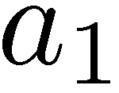

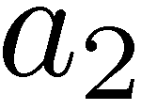

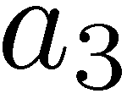
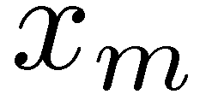




New Characterization

Slide 6
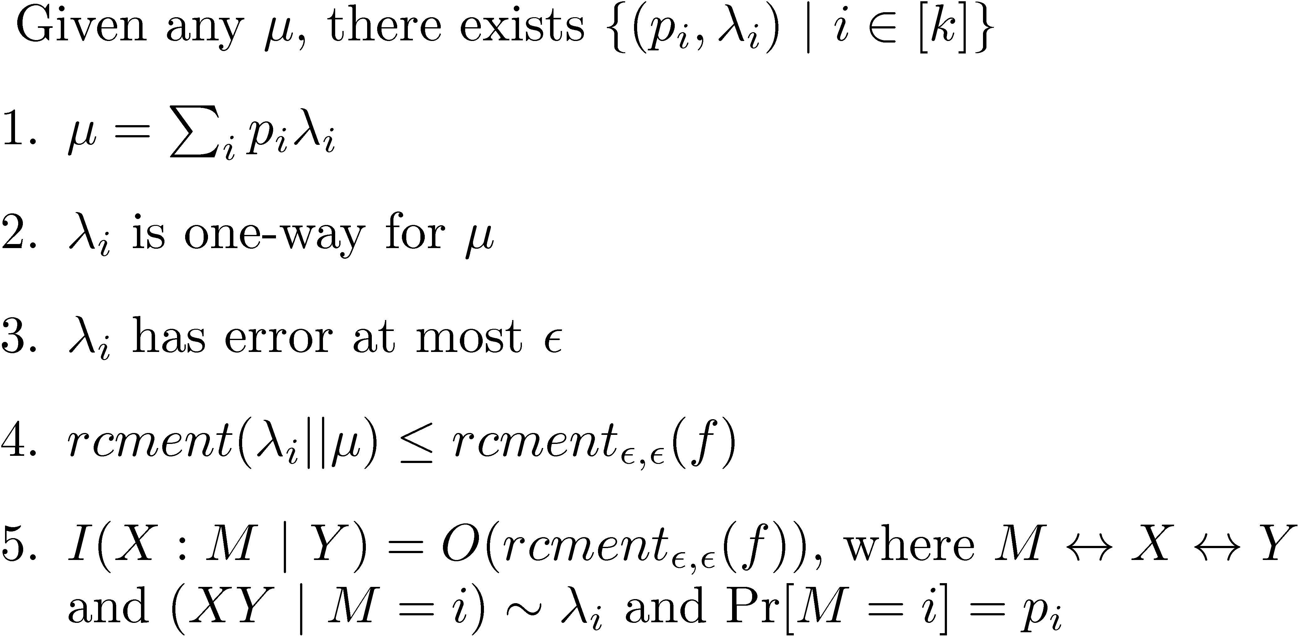




New Characterization
Use message compression of [Braverman, Rao 10] to get a one-way protocol with communication

Slide 7
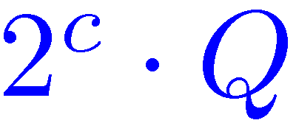







Message Compression
[Braverman, Rao 10]

Slide 8



Direct Product

Slide 9
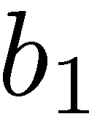
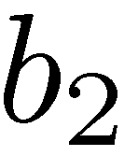
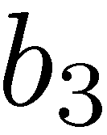
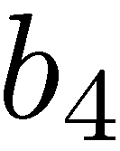


Two-way case

Slide 10



Application
Direct Product for Set Disjointness
[Razborov 92]
Our result

Slide 11
Questions ?
Thanks !

