Slide 1
Communication Complexity
Rahul Jain
Centre for Quantum Technologies and
Department of Computer Science
National University of Singapore.
TexPoint fonts used in EMF.
Read the TexPoint manual before you delete this box.: AAAAAAAAAAAAAAAAAAAA

Slide 2


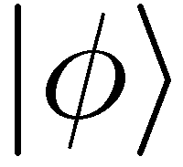
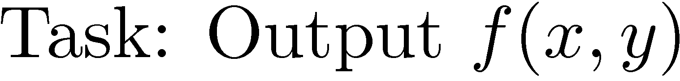
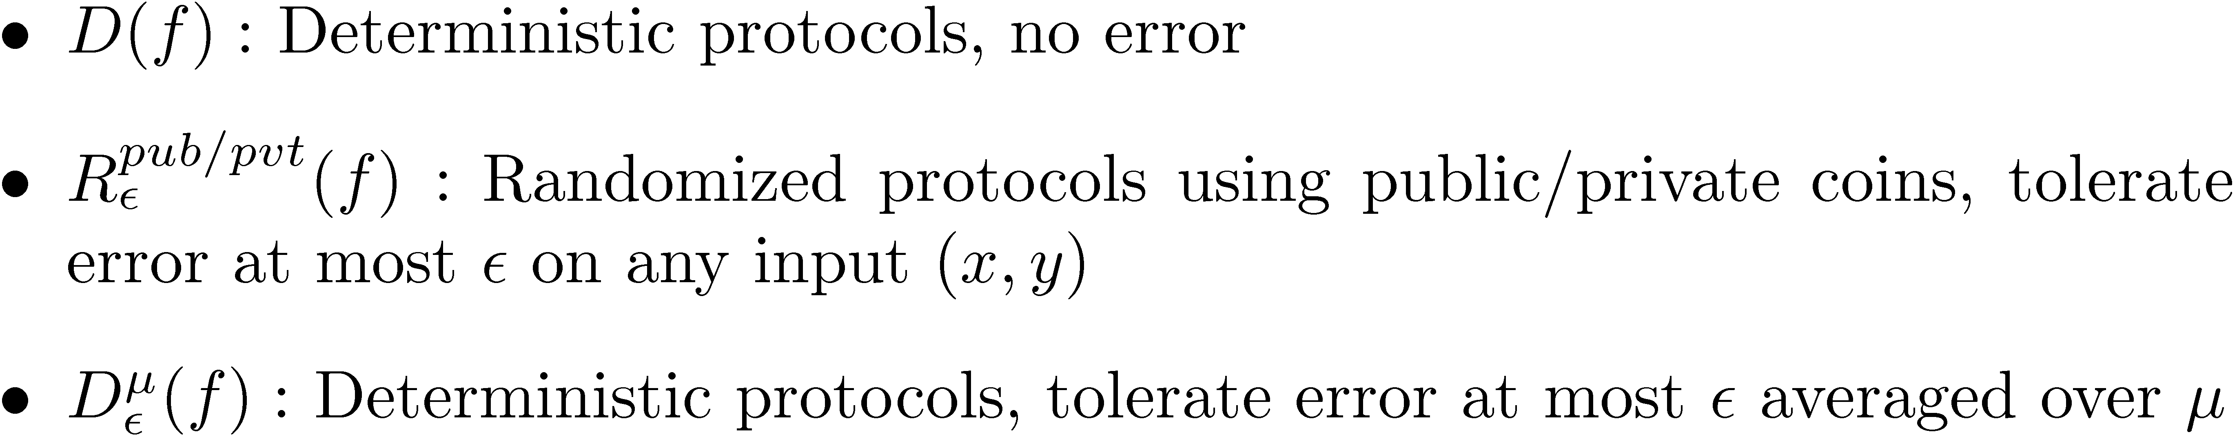
Communication Protocols

Slide 3
Why do we care ?
Generic tool for results in several areas of complexity theory
Circuit Lower Bounds, Formula Size Bounds
Time-Space trade-offs for Data Structure problems
Space lower bounds in the streaming model
Direct Sum leading to possible class separations like NC₁ and NC₂
Showing lower bounds for Locally Decodable Codes

Slide 4
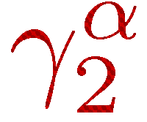
Two main topics we will look at
Lower bound methods
  the rectangle bound, the smooth rectangle bound
  the discrepancy bound, the smooth discrepancy bound (equivalently the bound equivalently the approximate rank bound)
  the partition bound
Direct Sum and Direct Product results
  Two way model
  One way model
  Simultaneous Message Passing model

Slide 5
Lower Bound Methods

Slide 6
The Rectangle Bound
[Yao 83; Babai, Frankl, Simon 86; Razborov 92]
A deterministic protocol with c bits of communication divides the inputs into at most 2^{c} rectangles.

Slide 7
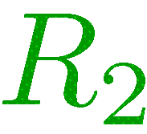
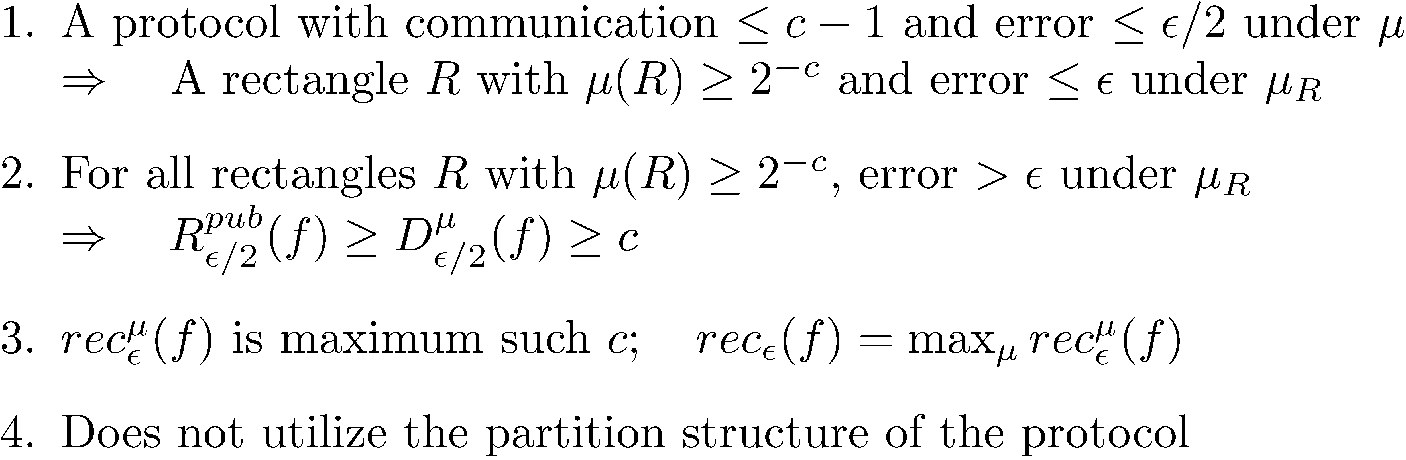
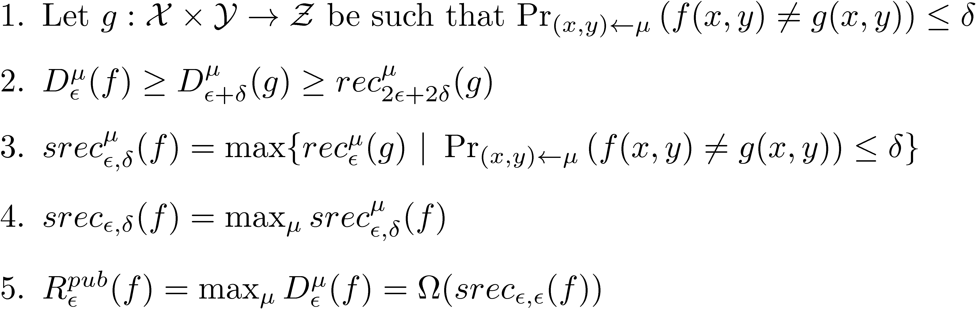
The Rectangle Bound
The Smooth Rectangle Bound
[J, Klauck 10]
[Yao 79]

Slide 8
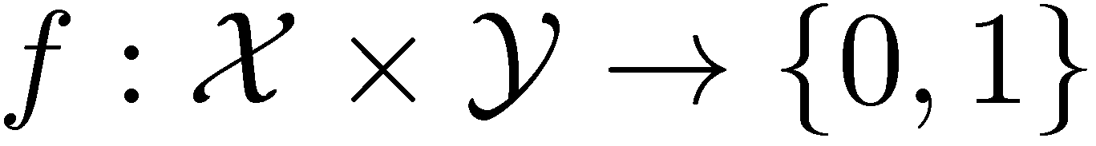
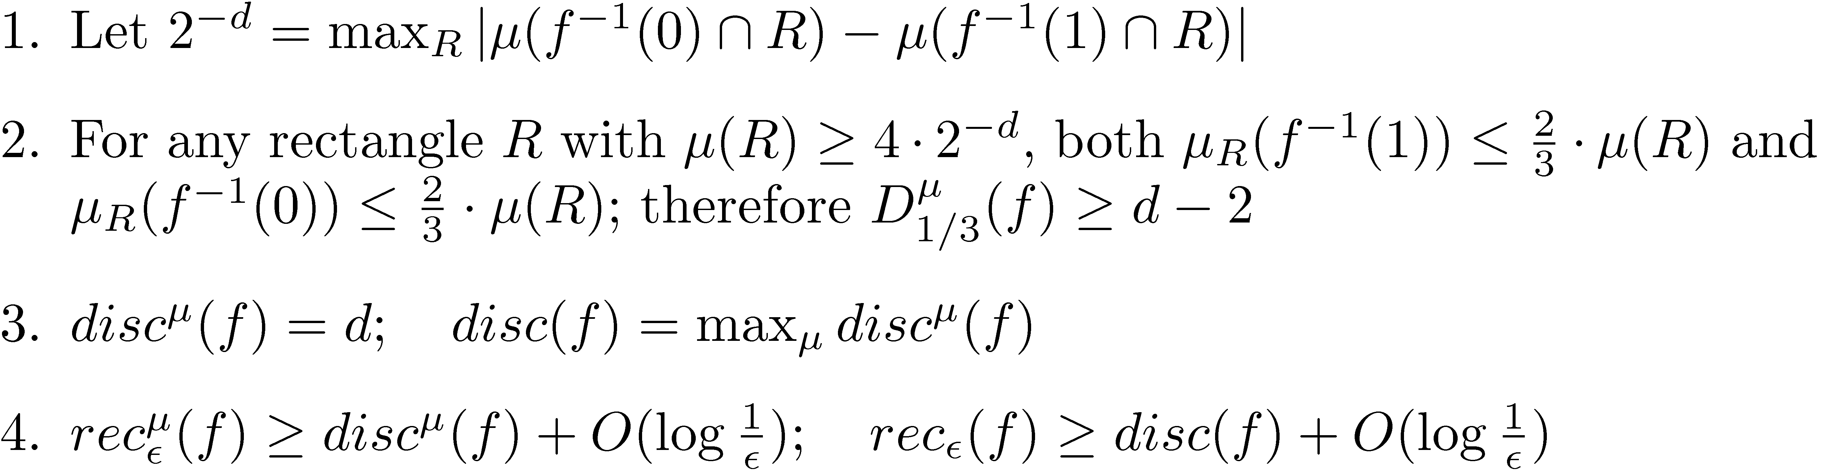
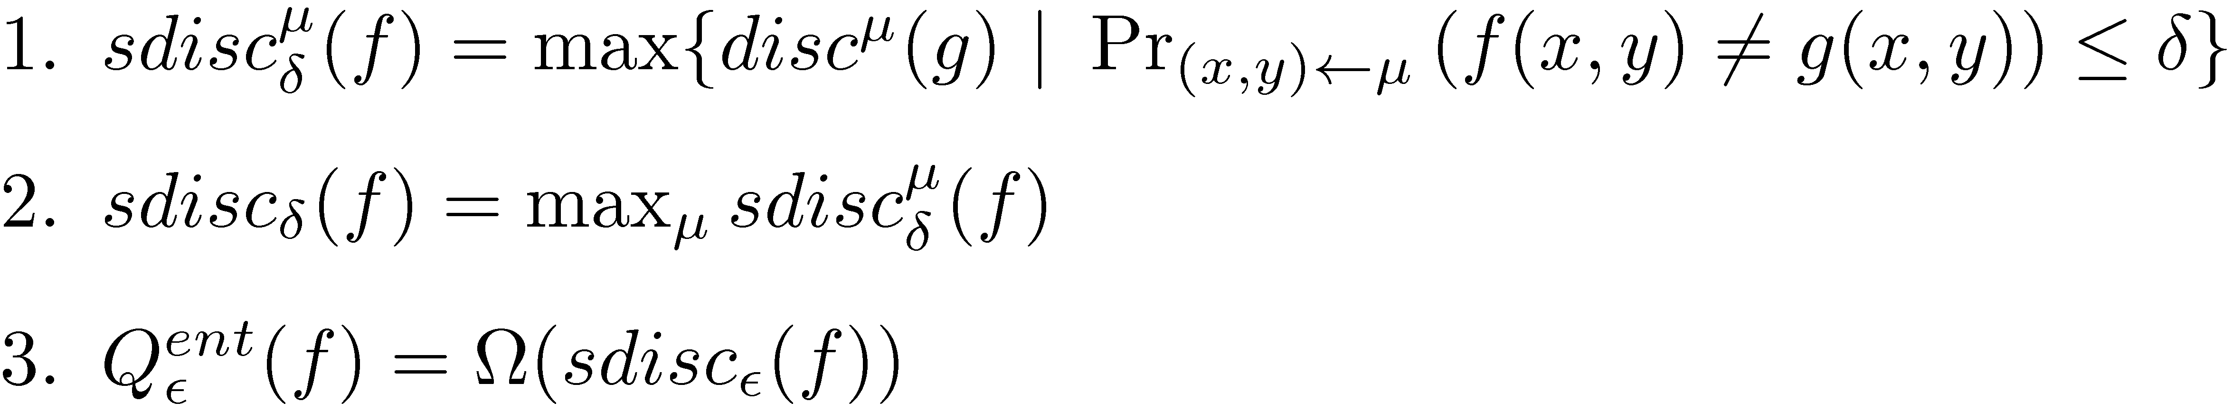
The Discrepancy Bound
[Yao 83; Babai, Frankl, Simon 86]
The Smooth Discrepancy Bound
[Klauck 07, Linail Shraibman 07]
The smooth discrepancy bound is equivalent to the γ₂ bound.
[Linial, Shraibman 07], [Lee, Shraibman 08].

Slide 9
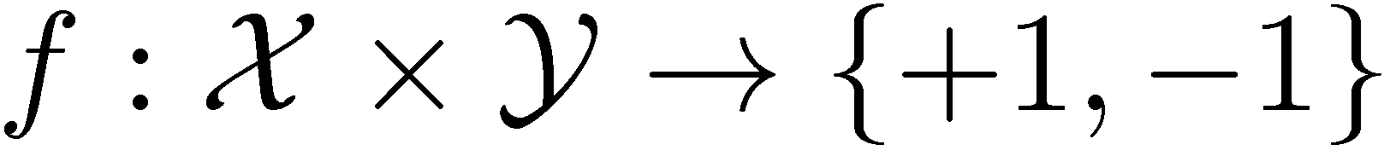
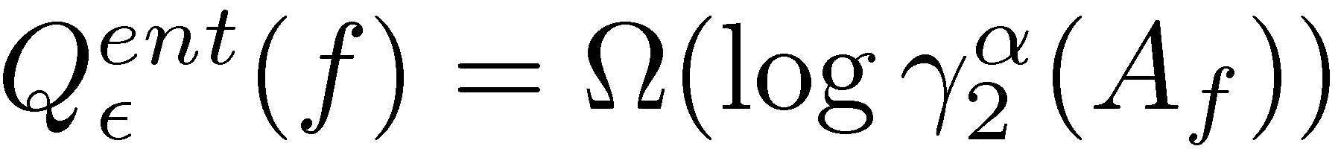

Quantum World: The γ₂ Bound
[Linial, Shraibman 07]
The master lower bound : beats all other generic lower bounds
Incomparable with information theoretic lower bound methods which are not generic and not known to beat the γ₂ bound either

Slide 10
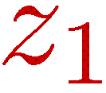
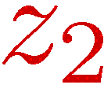
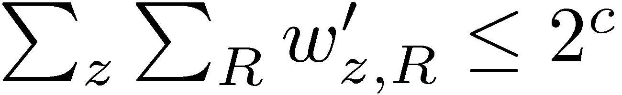
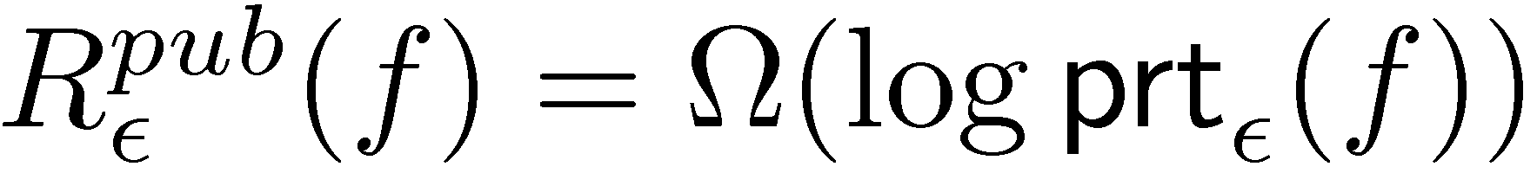
The Partition Bound
[J, Klauck 10]
Public-coin protocol with communication c

Slide 11
The Partition Bound

Slide 12

The Partition Bound for Relations

Slide 13
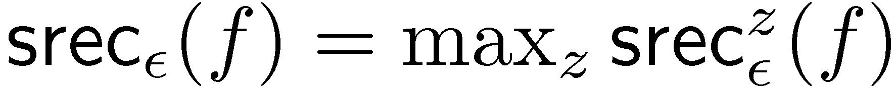
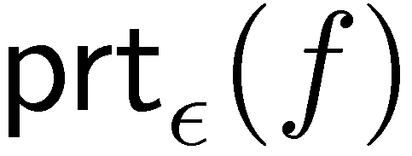
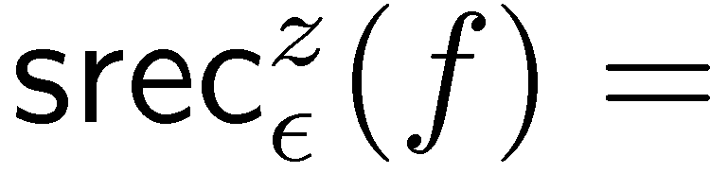

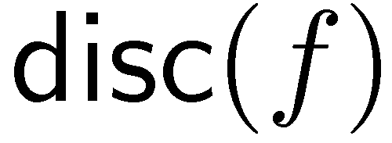

All these bounds can be captured by linear programs
Smooth Rectangle Bound
Partition Bound
Rectangle Bound [Lovász 90]
Discrepancy Bound

Slide 14
Applications
[Klauck 10]
[Chakrabarti, Regev 11]
Simpler proofs [Vidick 11, Sherstov 11]

Slide 15
Questions
Summary

Slide 16
Direct Sum and Direct Product

Slide 17
Direct Sum
Can we solve k copies faster ?

Slide 18


Direct Product
Can we solve k copies faster ?
Let there be ERROORR!

Slide 19
Why do we care ?
Direct Sum for Deterministic communication complexity for some relations can show strong complexity class separations
Direct Sum arguments lead to results in Data Structure model
Direct Product argument used for Privacy Amplification for Bounded Storage Model in Cryptography
Communication-Entanglement trade-offs for quantum protocols using Direct Product for a classical relation !
Communication-Space trade-offs using Direct Product
Direct Product in other models well studied e.g Raz’s Parallel Repetition, Yao XOR Lemma

Slide 20
Direct Sum – Two way model
Can we solve k copies faster ?
[Karchmer, Kushilevitz, Nisan 92]
[Chen, Barak, Braverman, Rao 10]
[Braverman, Rao 10]
[Harsha, J, McAllester, Radhakrishnan 07]
No, My Dear!

Slide 21

Direct Sum – One Way and SMP models
[Chakrabarti, Shi, Yirth, Yao 00]
[J, Radhakrishnan, Sen 05]
[J, Klauck 09]

Slide 22
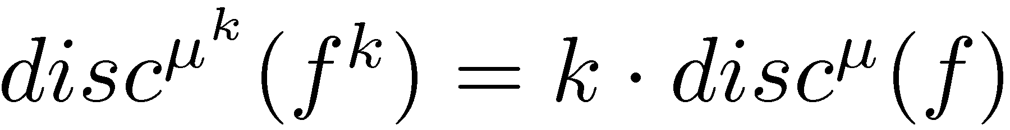
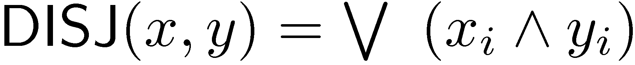
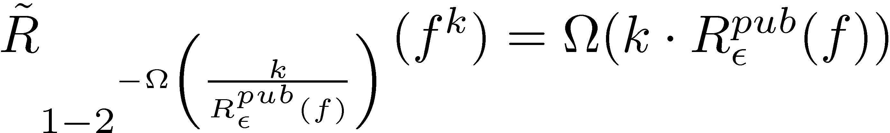
Direct Product
[Shaltiel 03]
This implies direct product for
[Lee, Shraibman, Špalek 08]
[Sherstov 10]
Implies direct product for first shown by [Klauck, Špalek, de Wolf 07]
[Parnafes, Raz, Wigderson 97]

Slide 23
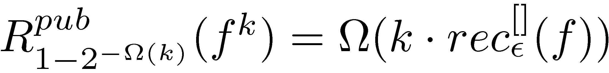
Direct Product
[Beame, Pitassi, Segerlind, Wigderson 05]
[J, Klauck, Nayak 08]
[Klauck 10]
[J 10]
Implies result of [J, Klauck, Nayak 08] and [Shaltiel 03]

Slide 24


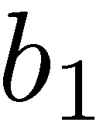
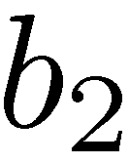
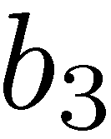
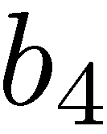

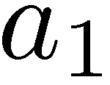

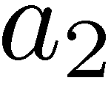
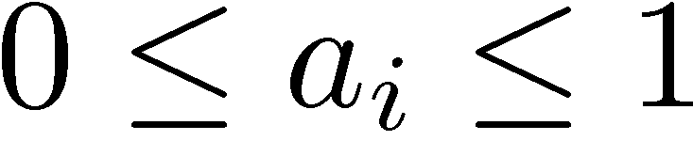
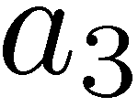
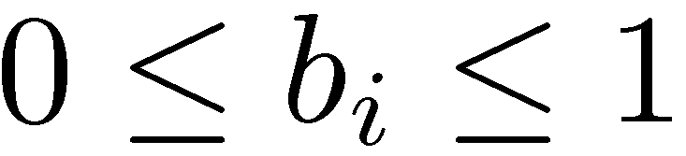
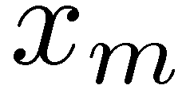
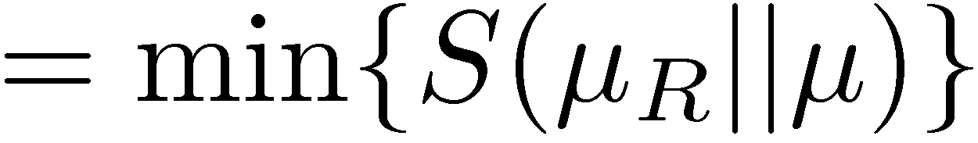
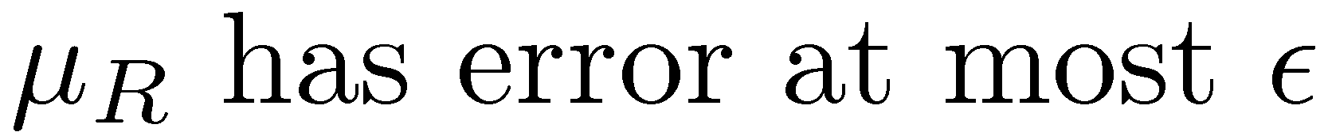
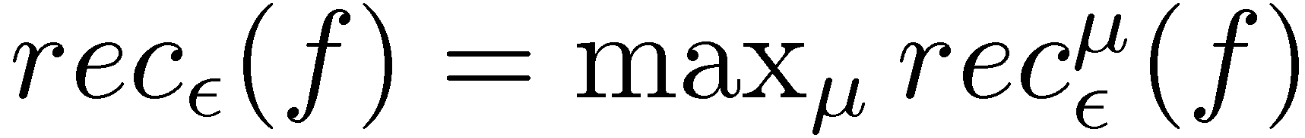
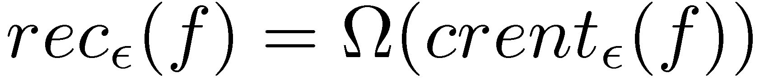
Conditional relative entropy bound (crent)

Slide 25
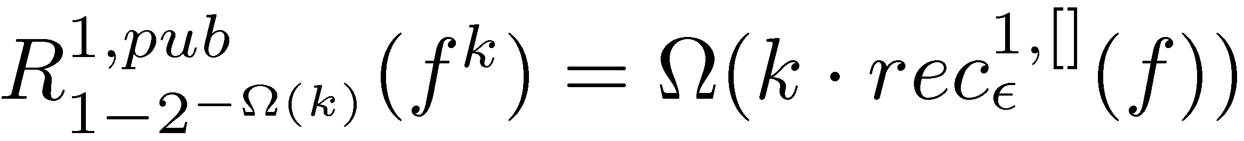
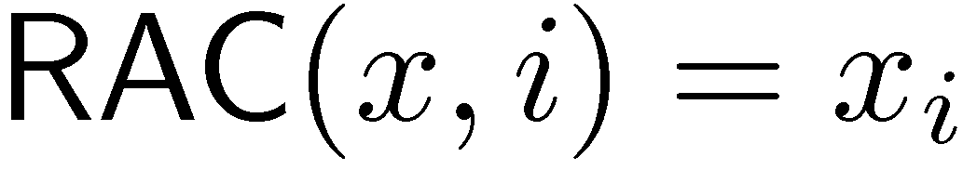
Direct Product
[J, Klauck, Nayak 08]
[Ben-Aroya, Regev, de Wolf 08]
[Gavinsky 08]
Implied communication entanglement trade-off
[J 10]

Slide 26
Questions ?
Thanks !

