Slide 1
Lasserre Hierarchy, Higher Eigenvalues, and Graph Partitioning
Venkatesan Guruswami
Carnegie Mellon University
Joint work with Ali Kemal Sinop
--- Mysore Park Workshop, August 10, 2012 ---

Slide 2
Talk Outline
Introduction to problems we study
Laplacian eigenvalues and our results
Lasserre hierarchy
Case study: Minimum bisection
Concluding remarks

Slide 3
Graph partitioning problems
Minimum bisection: Given edge-weighted graph G=(V,E,W), find partition of vertices into two equal parts cutting as few (in weight) edges as possible:
More generally: Minimum μ-section
  Find subset S ⊂ V of size μ to minimize cut size
  δ_{G}(S) = weight of edges leaving S = |E(S,S^{c})|
Related problems:
  Small set expansion: weight vertices by degree,
  find S ⊂ V minimizing δ_{G}(S) with Vol(S)= sum of degrees in S = μ
  Sparsest cut (find best ratio cut over all sizes)
1
2
3
4
1
2
3
4
Cost=2

Slide 4
Many Practical Applications
Building block for divide-and-conquer on graphs
VLSI layout
Packet routing in distributed networks
Clustering and image segmentation
Robotics
Scientific computing

Slide 5
Approximation Algorithms
Unfortunately such cut problems are NP-hard.
Find an α-factor approximation instead.
  If minimum cost = OPT, algorithm always finds a solution with value ≤ α OPT.
Rounding Algorithm: Solve a convex relaxation and round the “fractional” solution to “integral” solution.
α
0
Relaxation
OPT
Algorithm
α OPT
Integrality Gap

Slide 6
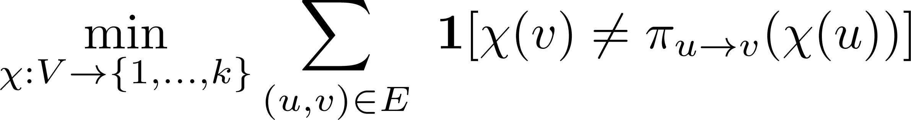
A notorious problem: Unique Games
Graph G=(V,E)
Number of labels k
For each edge e=(u,v),
  A permutation
Goal: Label vertices with k colors to minimize number of unsatisfied edges

Slide 7
Unique Games: Example
Suppose k=3.
1
1
2
2
3
1
3
2
3
Constraint Graph
1
2
A cloud of k=3 vertices
per vertex of G
3
Label Extended Graph

Slide 8
Example
A labeling:
1
2
3
1
1
2
2
3
3
Constraint Graph
1
2
3
Label Extended Graph

Slide 9
Unique Games: Example
Unsatisfied constraints:
  (in red’s neighborhood)
1
2
3
1
1
2
2
3
3
Constraint Graph
1
2
3
Label Extended Graph

Slide 10
Unique Games: Example
Unsatisfied constraints:
  (in red’s neighborhood)
1
2
3
1
1
2
2
3
3
Constraint Graph
1
2
3
Label Extended Graph

Slide 11
Unique Games = Special sparse cut
Find subset S of fraction 1/k vertices
in label extended graph,
containing one vertex in each cloud,
minimizing δ(S)
1
1
2
2
3
1
3
2
3
Constraint Graph
1
2
3
Label Extended Graph

Slide 12
Let OPT = fraction of unsatisfied edges
in optimal labeling
Unique Games conjecture [Khot’02]
ε > 0 ∃ k = k(ε) s.t. it is NP-hard to tell if an instance of Unique Games with k labels has
OPT ≤ ε or
OPT ≥ 1- ε.
i.e., even if ∃ a “special cut” with expansion ≈ ε,
it is hard to find a “special cut” with expansion ≈ 1- ε

Slide 13
Our work
Approximation algorithms for these problems using semidefinite programs from the Lasserre hierarchy
  Min-Bisection
  Small Set Expansion
  Sparsest Cut
  Min-Uncut / Max-Cut
  Independent Set
  As well as k-partitioning variants:
    Min-k-Section
    Unique Games

Slide 14
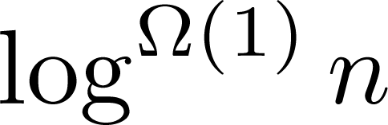
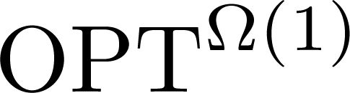
Motivations: Algorithmic Perspective
These are fundamental, well-studied, practically relevant, optimization problems
Yet huge gap:
  Approximability: or
  Hardness: not even factor 1.1 known to be NP-hard
Natural goal: Close (or reduce) the gap
SDPs one of the principal algorithmic tools
  Extend algorithmic techniques to more powerful SDPs.

Slide 15
Motivations: Complexity Perspective
No consensus opinion
on its validity
[Khot’02] Unique Games Conjecture
  UGC has many implications: tight results for all constraint satisfaction and ordering problems, vertex cover,…
[Raghavendra, Steurer’10] Small Set Expansion Conj. (SSEC):
  O(1)-approximation for Small Set Expansion is hard.
  Implies the UGC [RS’10], plus ω(1) hardness for bisection, sparsest cut, minimum linear arrangement, etc. [R,S,Tulsiani’12]
Despite these bold conjectures, following is not ruled out:
  Can 5-rounds of Lasserre Hierarchy SDP relaxation
  refute the UGC?
Investigate this possibility…
Identify candidate hard instances (if there are any!)

Slide 16
Talk Outline
Introduction to problems we study
Laplacian eigenvalues and our results
Lasserre hierarchy
Case study: Minimum bisection
Concluding remarks

Slide 17

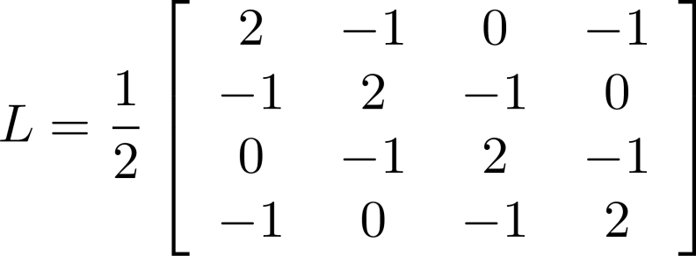
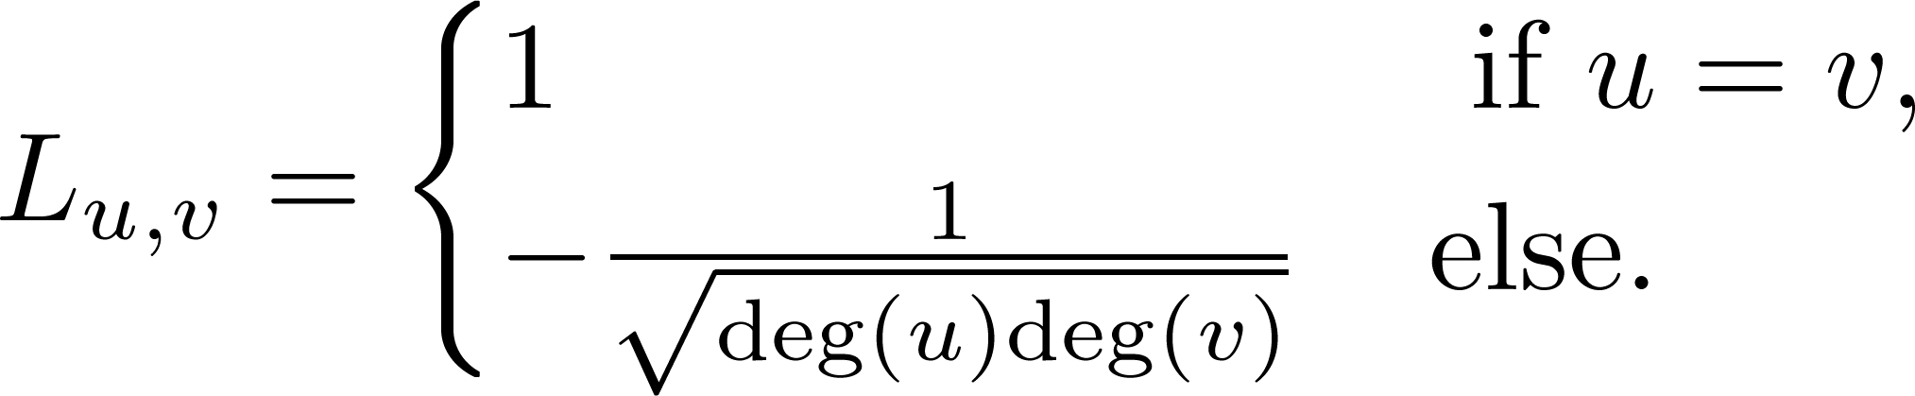
Laplacian and Graph Spectrum
1
2
3
4
rows and cols
indexed by V
0 = λ₁ ≤ λ₂ ≤ … ≤ λ_{n} ≤2 and λ₁ + λ₂ + … + λ_{n} = n,
λ₂: Measures expansion of the graph through Cheeger’s inequality .
λ_{r}: Related to small set expansion [Arora, Barak, Steurer’10], [Louis,Raghavendra,Tetali,Vempala’11], [Gharan, Lee,Trevisan’11].

Slide 18
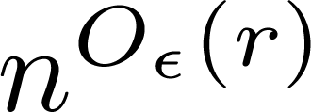
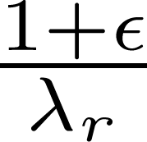
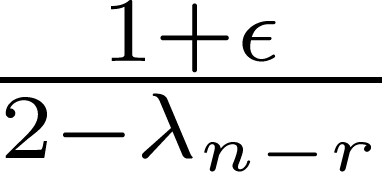
Our Results I
By rounding r/ε^{O(1)} round Lasserre hierarchy SDPs, in time we obtain approximation factor
Note we get approximation scheme
  0 = λ₁ ≤ λ₂ ≤ … ≤ λ_{n} ≤2 and λ₁ + λ₂ + … + λ_{n} = n,
Minimum Bisection*
Small Set Expansion*
Uniform Sparsest Cut
Their k-way generalizations*
Minimum Uncut (min. version of Max Cut)
More generally, our methods apply to quadratic integer programming problems with positive semidefinite objective functions
For r=n, λ_{r} >1, λ_{n-r} <1
* Satisfies constraints within factor of 1 ± o(1)

Slide 19
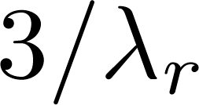
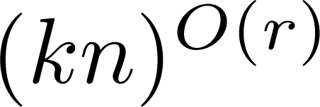
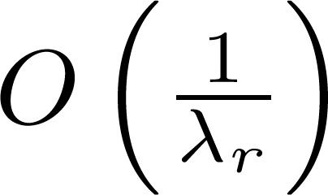
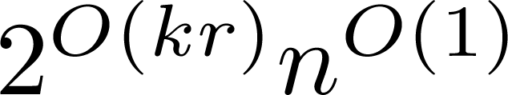
Our Results II: Unique Games
For Unique Games, a direct bound will involve spectrum of label extended graph, whereas we want to bound using spectrum of original graph.
  We give a simple embedding and work directly on the original graph.
We obtain factor in time
  Concurrent to our work, [Barak-Steurer-Raghavendra’11] obtained factor in time (using weaker Sherali-Adams SDP).
Combining with [Arora-Barak-Steurer’10] “higher order Cheeger” thm.
⇒ UG with compl. 1- ε^{O(1)} is easy for n^{ε} levels of Lasserre Hierarchy

Slide 20
Interpretation
Our results show that these graph partitioning problems are easy on many graphs
Also hints at why showing even weak hardness results has been elusive
Points to the power of Lasserre hierarchy
  Could be a serious threat to small set expansion conjecture, or even UGC.
  Recent work [Barak,Brandao,Harrow,Kelner,Steurer,Zhou’12] shows O(1) rounds enough to solve known gap instances

Slide 21
Our Results III
Normalized Laplacian eigenvalues
0 = λ₁ ≤ λ₂ ≤ … ≤ λ_{n} ≤ 2 and λ₁ + λ₂ + … + λ_{n} = n,
Independent set: O(1) approximation in n^{O(r)} time when r’th largest eigenvalue
λ_{n-r} ≤ 1 + O(1/d_{max})
  ≈ O(d_{max}/t) approximation if λ_{n-r} ≤ 1 + 1/t
[Arora-Ge’11] Given 3-colorable graph,
find independent set of size n/12 in n^{O(r)} time if
λ_{n-r} < 17/16.

Slide 22
Talk Outline
Introduction to problems we study
Laplacian eigenvalues and our results
Lasserre hierarchy
Case study: Minimum bisection
Concluding remarks

Slide 23

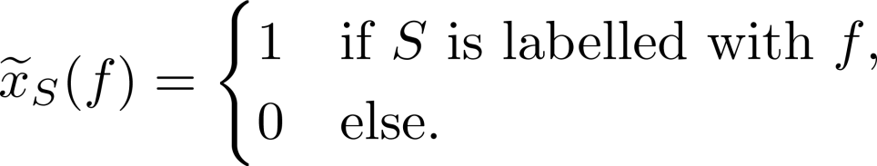
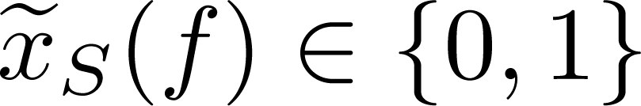
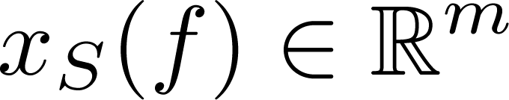
Basic Lasserre Hierarchy Relaxation
Quadratic IP formulation for a k-labeling problem: For each S of size ≤ r, and
each possible labeling f : S → {0,1,…,k-1}
    Boolean variable representing:
  with all implied pairwise consistency constraints.
(SDP Relaxation) Replace with
r = number of rounds/levels of Lasserre hierarchy;
Resulting SDP can be solved in n^{O(r)} time

Slide 24
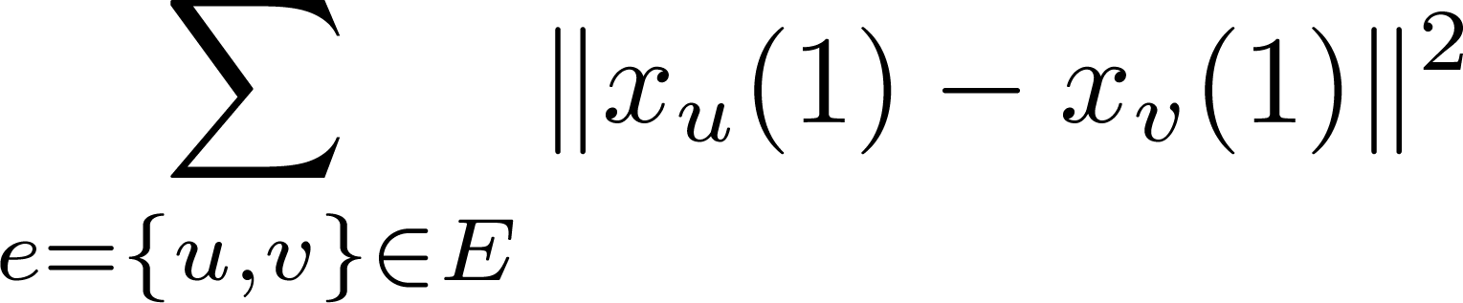

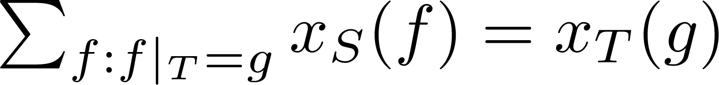
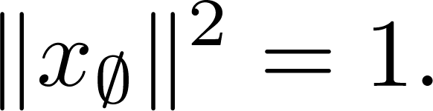
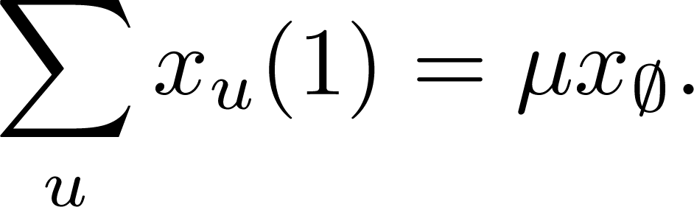
Lasserre Relaxation for Minimum Bisection
Given d-regular graph G, find subset U of size μ minimizing δ_{G}(U)
Intended integral value of x_{u}(1) : 1 if u ∈ U, and 0 otherwise.
Relaxation for consistent labeling of all subsets of size ≤r:
Cut cost
Minimize
Consistency
Marginalization
Distribution
Partition SIze

Slide 25
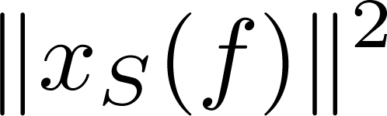
Intuition Behind Lasserre Relaxation
  For each S, the vectors x_{S}(f) give a local distribution on labelings f : S → {0,1}
    Prob. of f =
Inner products of vectors (x_{S}(f))_{S,f} represent joint probabilities (give a psd moment matrix)
Division corresponds to conditioning:

Slide 26
Previous Work on Lasserre Hierarchy
Few algorithmic results known before, including:
  [Chlamtac’07], [Chlamtac, Singh’08] n^{Ω(1)} approximation for 3-coloring and independent set on 3-uniform hypergraphs,
  [Karlin, Mathieu, Nguyen’10] (1+1/r) approximation of knapsack for r-rounds.
Some known integrality gaps are:
  [Schoenebeck’08], [Tulsiani’09] Most NP-hardness results carry over to Ω(n) rounds of Lasserre.
  [Bhaskara, Charikar, G., Vijayaraghavan, Zhou’12] Densest k-subgraph (n^{Ω(1)} integrality gap for Ω(n) rounds of Lasserre hierarchy)

Slide 27
Rounding Lasserre Relaxation
For regular SDP [Goemans, Williamson’95] showed that with hyperplane rounding:
No analogue known for rounding Lasserre Relaxation
Here: an intuitive local propagation based rounding framework
  Analysis via projection distance, and connections to ``column selection” in low-rank matrix approximation

Slide 28
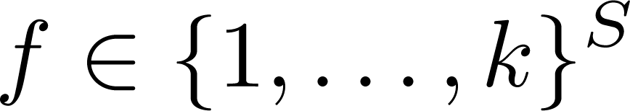

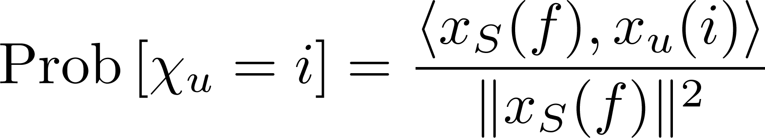
General Rounding Framework
(Seed Selection) Choose appropriate seed set S.
(Seed Labeling) Choose wp .
(Propagation) Perform randomized rounding.
  so that the output satisfies:
  (i.e., match the conditional prob. for label for i, given S got labeling f)
    Inspired by [Arora, Kolla, Khot, Steurer, Tulsiani, Vishnoi’08]
    algorithm for Unique Games on expanders:
    propagation from a single node chosen uniformly at random

Slide 29
Talk Outline
Introduction to problems we study
Laplacian eigenvalues and our results
Lasserre hierarchy
Case study: Minimum bisection
Concluding remarks

Slide 30
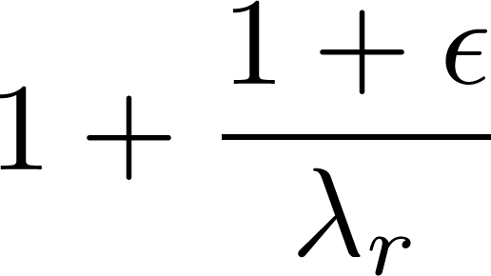
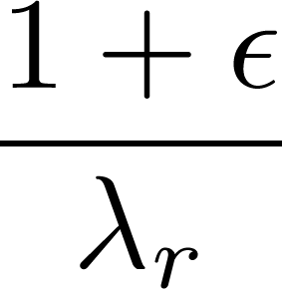
Case Study: Minimum Bisection
We will present some details of the analysis of rounding for the minimum bisection problem on d-regular unweighted graphs (for simplicity).
We will show that it achieves factor .
Obtaining factor requires some additional ideas.

Slide 31
Lasserre SDP for Min μ-section
Vector x_{S}(f) for each S of size ≤ r,
and each possible labeling f : S → {0,1}
Minimize

Slide 32

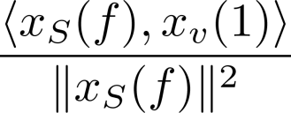
Rounding Algorithm
Given optimal solution to r’=O_{ε}(r) round Lasserre SDP:
Choose suitable seed set S of size r
  Details later
Partition S by choosing f with probability
Propagate to other nodes:
  For each node v independently
    With probability include v in U.
Return U.

Slide 33
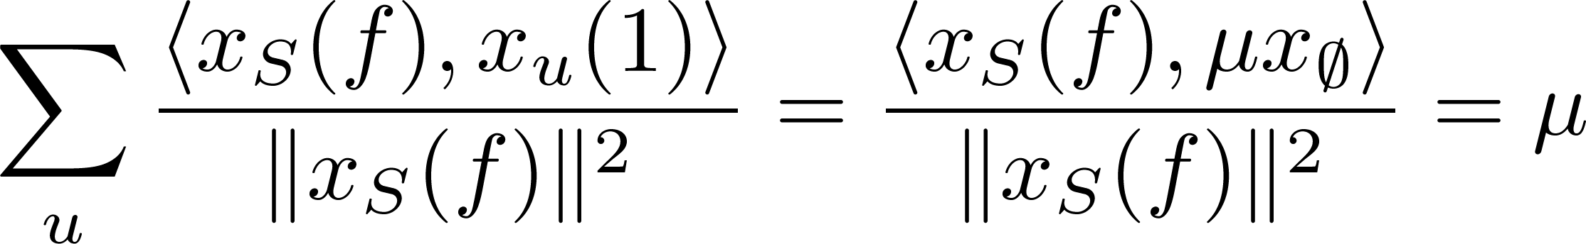

Analysis
Partition Size
  Each node is chosen into U independently
  Fixing S,f, expected size of U equals
  By Chernoff, with high probability
33

Slide 34
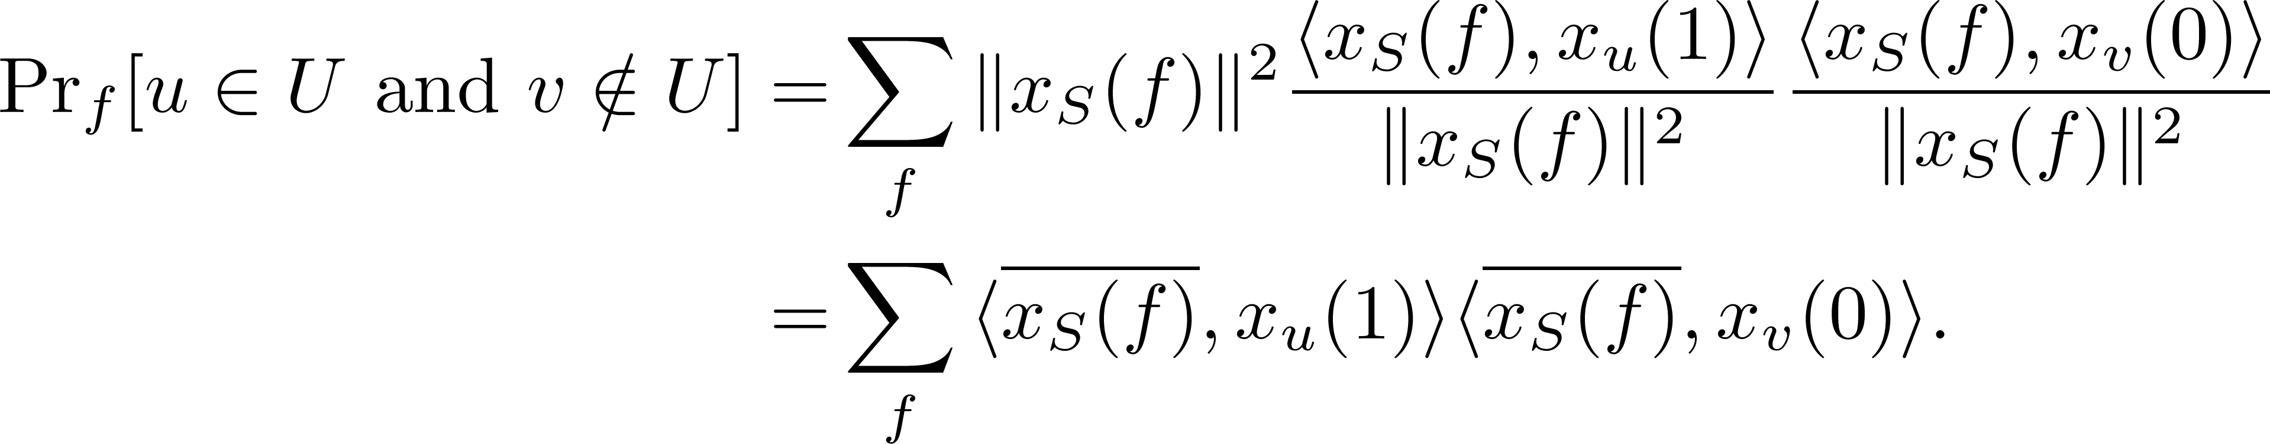
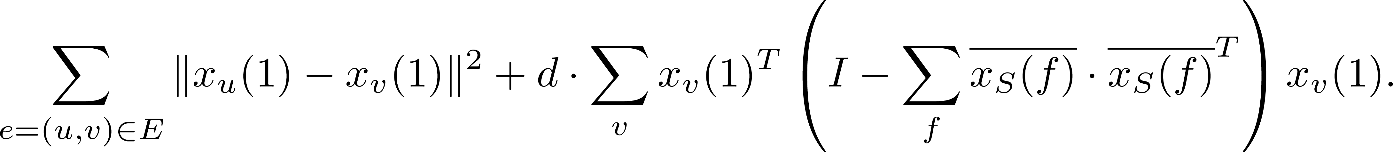
Analysis
By our rounding, for fixed seed set S,
After some calculations, we have the following bound on number of edges cut:
Normalized Vector for x_{S}(f)
≤ OPT
Call this matrix ∏_{S}

Slide 35
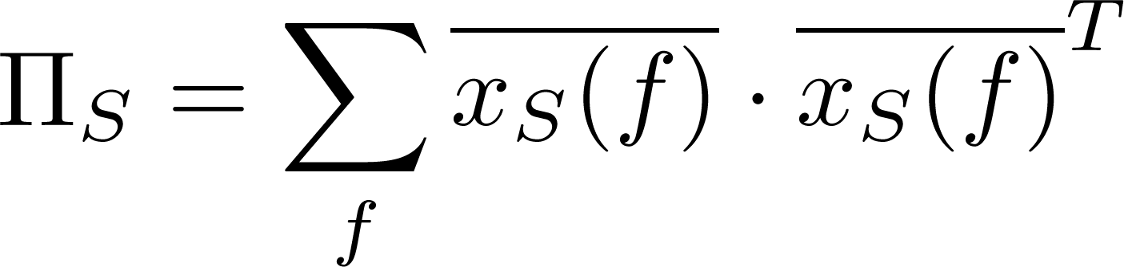
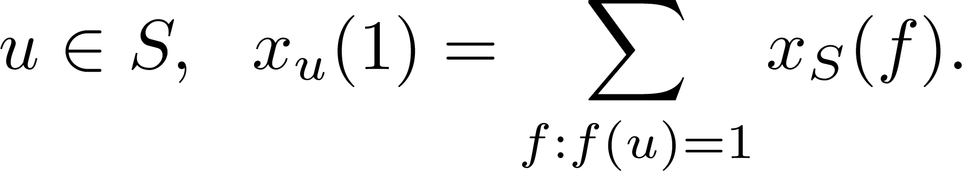
Matrix Π_{S}
Remember {x_{S}(f)}_{f} are orthogonal.
  is a projection matrix onto span{x_{S}(f)}_{f} .
For any
Let P_{S} be the corresponding projection matrix.

Slide 36
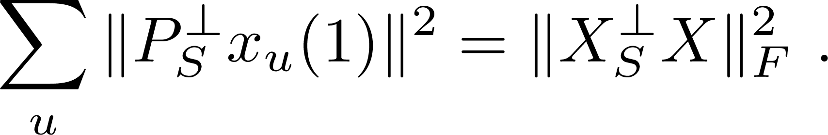
Picking the seed set
The final bound is:
Define X = matrix with columns {X_{u} = x_{u}(1)}
Want seed set S to minimize
Projection distance to span of columns { X_{u} : u ∈ S}

Slide 37
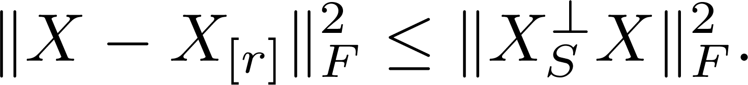
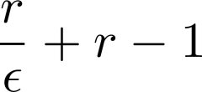
Column selection
Given matrix X ∈ R^{m x n}, pick r columns S to minimize
  Introduced by [Frieze, Kannan,Vempala’04]; studied in many works since.
For any S of size r this is lower bounded by:
[G.-Sinop] Can efficiently find set S of columns so that
  And this bound is tight.
Error of best rank-r approximation of X

Slide 38

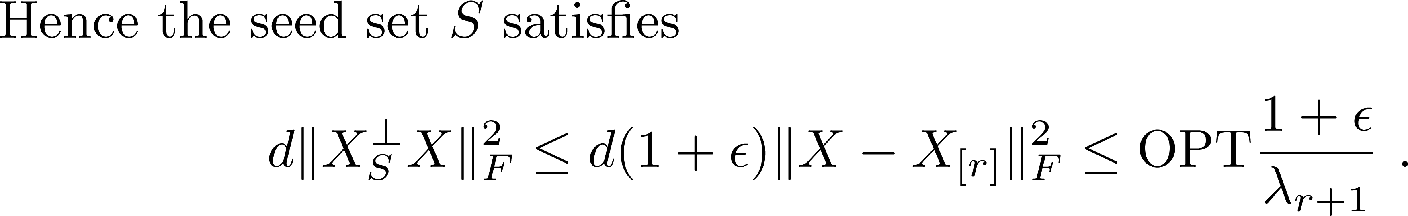
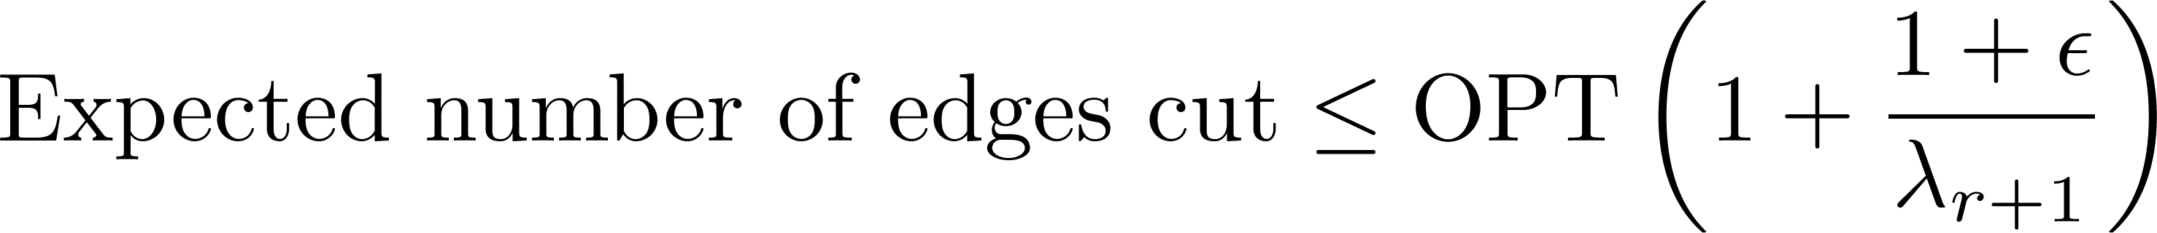
Relating Performance to Graph Spectrum
Can show: Worst case is when best rank-r approximation of X is obtained by first r eigenvectors of graph Laplacian.
Using Courant-Fischer theorem,
Therefore

Slide 39
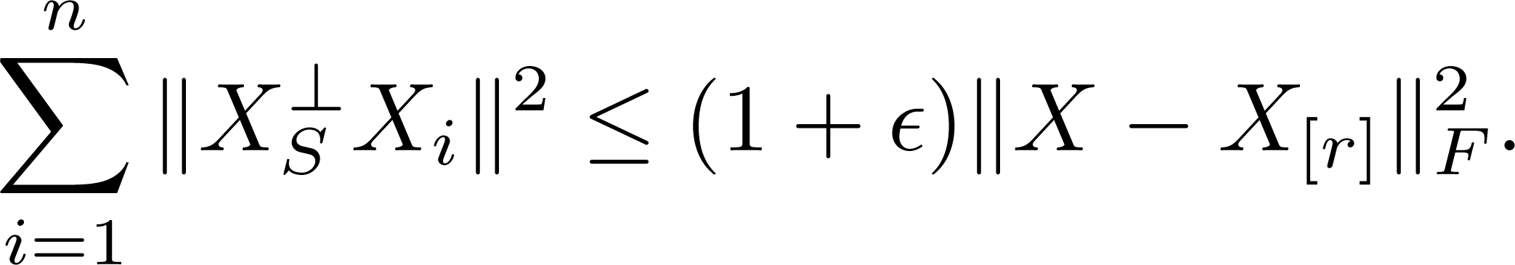
Few words about column selection
Given matrix X ∈ R^{m x n}, pick t columns S to minimize
[G.-Sinop] Can efficiently find set S of columns so that
Error of best rank-r approximation of X

Slide 40
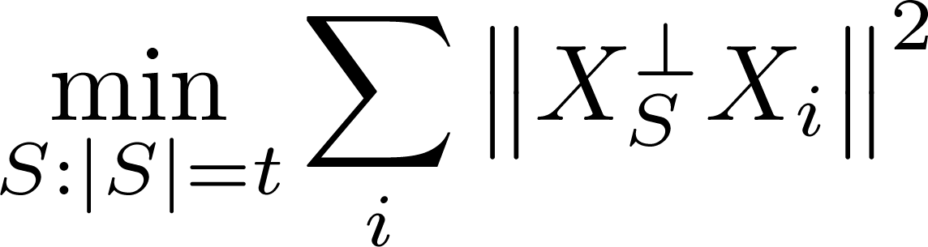
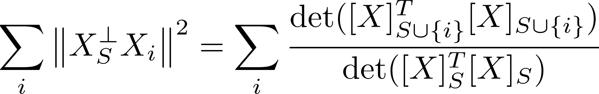

Proof Idea
Goal: (Min. projection dist.)
Observe
Choose S with probability
  Volume Sampling [Deshpande, Rademacher, Vempala, Wang’06]
Converts sum-of-ratios to ratio-of-sums.

Slide 41
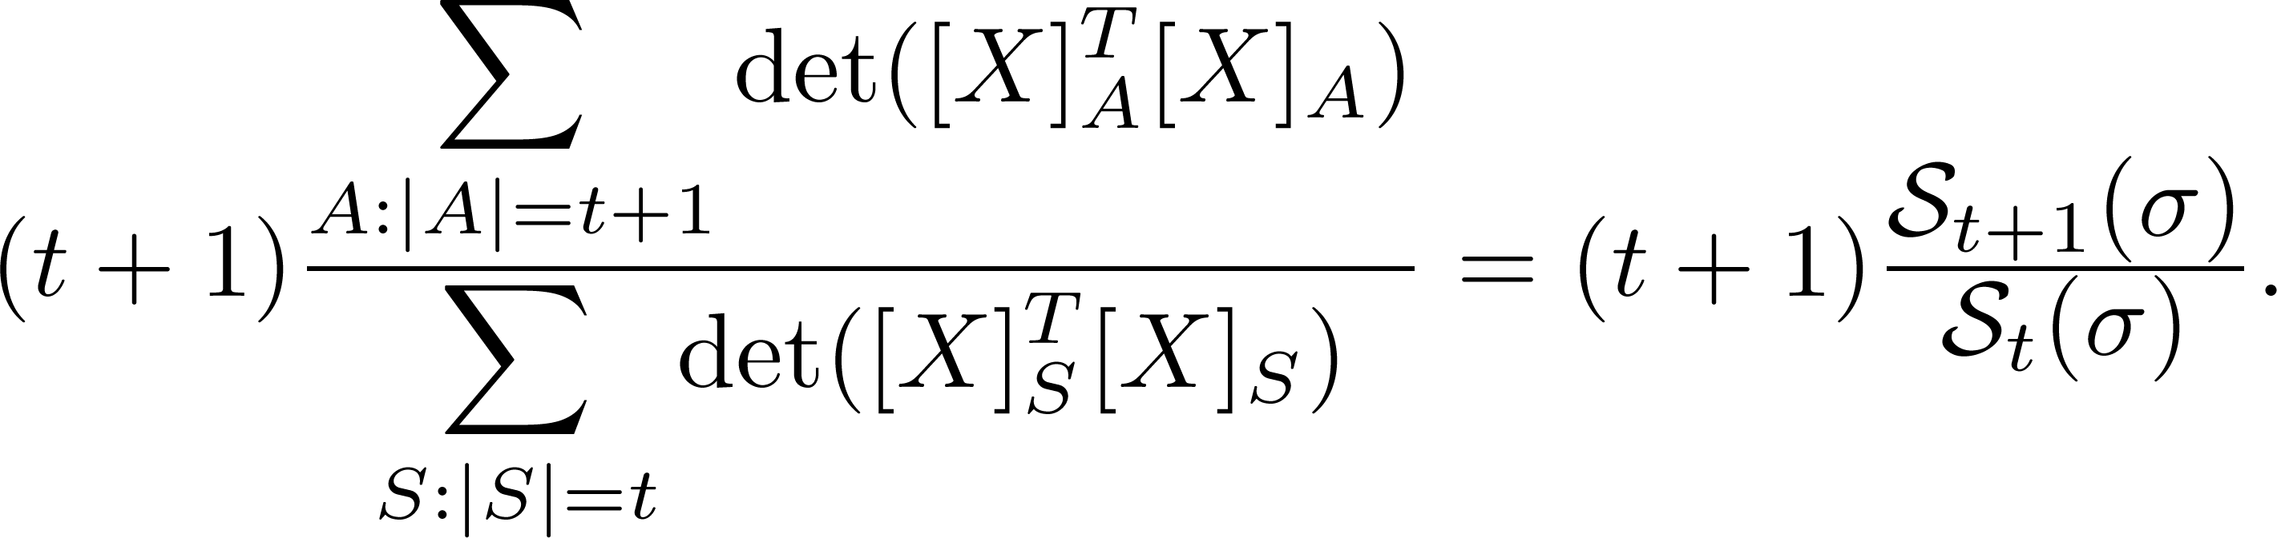
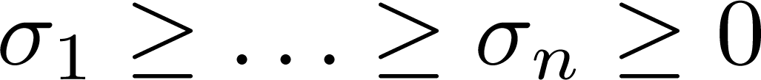
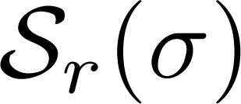
Proof Idea (contd.)
Expected projection distance achieved by
volume sampling equals
where are eigenvalues of X^{T} X,
is r^{th} symmetric form.

Slide 42
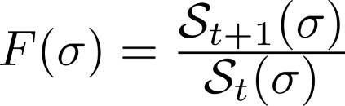
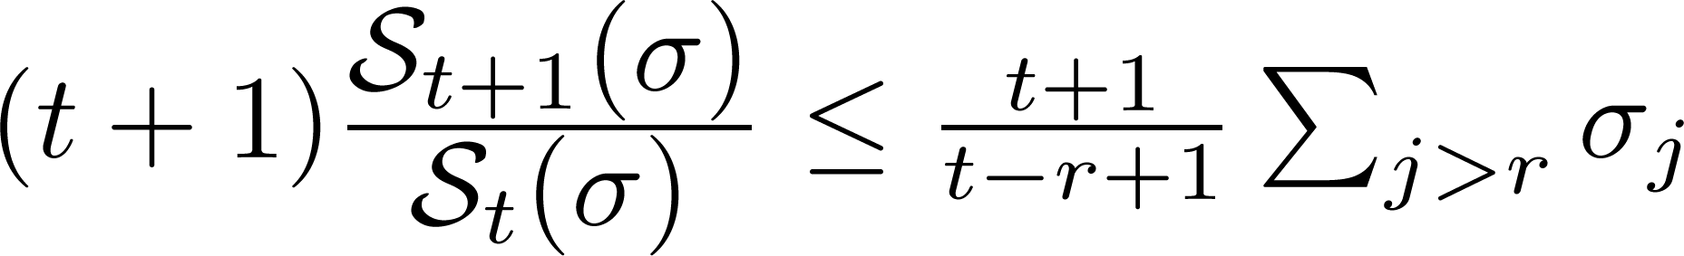
Schur Concavity
is a Schur-Concave function.
  F(σ) ≤ F(ρ) if σ majorizes ρ
For a fixed prefix sum
F(σ) is maximized by
Substituting back:
Best rank-r approximation
error.

Slide 43
Talk Outline
Introduction to problems we study
Laplacian eigenvalues and our results
Lasserre hierarchy
Case study: Minimum bisection
Concluding remarks

Slide 44
Summary
Rounding for Lasserre hierarchy SDPs for certain QIPs + analysis based on column selection
  Approximation scheme-like guarantees for several graph partitioning problems
  n^{O(r)} time to solve r-levels of hierarchy. Rounding framework only looks at 2^{O(r)} n^{O(1)} bits of solution.
  Can also make runtime 2^{O(r)} n^{O(1)} [G.-Sinop, FOCS’12]
Lasserre SDP seems very powerful
  Only very weak integrality gaps known for the studied problems

Slide 45
Open questions
Can O(log n) rounds of Lasserre hierarchy refute SSE conjecture? Refute UGC?
  Currently no candidate hard instances for even 5 rounds
0.878 approx. for Max-Bisection? (0.85 [Raghavendra-Tan’12])
Integrality gaps for Lasserre hierarchy beating NP-hardness (or matching UG/SSE-hardness) results
  [Tulsiani’09] For Max k-CSP, clique/coloring
  [G.-Sinop-Zhou’12] Balanced separator, uniform sparsest cut
  [Bhaskara, Charikar, G., Vijayaraghavan, Zhou’12] Densest k-subgraph (n^{Ω(1)} integrality gap for Ω(n) rounds of Lasserre hierarchy)

