Slide 1
Selfish Flows over Time
Umang Bhaskar, Lisa Fleischer
Dartmouth College
Elliot Anshelevich
Rensselaer Polytechnic Institute

Slide 2
Selfish Flows over Time
Umang Bhaskar, Lisa Fleischer
Dartmouth College
Elliot Anshelevich
Rensselaer Polytechnic Institute
(I have animations)

Slide 3
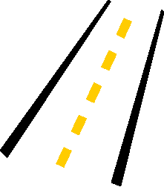
Uncoordinated Traffic
on roads
in communication
and in other networks

Slide 4



Uncoordinated Traffic
A
B

Slide 5
Uncoordinated Traffic
A
B
Players choose their route selfishly
(i.e., to minimize some objective)

Slide 6
System Performance
For a given objective,
how well does the system perform,
for uncoordinated traffic routing?

Slide 7
System Performance
For a given objective,
how well does the system perform,
for uncoordinated traffic routing?

Slide 8
Price of Anarchy
For a given objective,
how well does the system perform,
for uncoordinated traffic routing?
Objective for uncoordinated traffic routing
Price
Of
Anarchy
=
Objective for coordinated routing
which minimizes objective

Slide 9
Price of Anarchy
For a given objective,
how well does the system perform,
for uncoordinated traffic routing?
Objective: Time taken by all players to reach destination
Time taken for uncoordinated traffic routing
Price
Of
Anarchy
=
Minimum time taken
we will refine this later

Slide 10
Modeling Uncoordinated Traffic
How do we model uncoordinated traffic?

Slide 11
Modeling Uncoordinated Traffic
How do we model uncoordinated traffic?
Routing games with static flows
- allow rigorous analysis
- capture player “selfishness”
- network flows, game theory
Tight bounds on PoA in this model

Slide 12
Static Flows
f
e
s
t

Slide 13
Flows over Time
s
t
- Edges have delays
- Flow on an edge varies with time

Slide 14
Flows over Time
100 bps
2 seconds
1000 bits
Arrival graph:
Total time: 11 seconds
100
What’s the “quickest flow”?
bits
per
second
1
2
3
4
5
6
7
8
9
10
11
12
time

Slide 15
Flows over Time
Edge capacity c_{e}
s
t
Edge delay d_{e}
Flow value v
Total time: ?
What’s the “quickest flow”?

Slide 16
Flows over Time
c₇ , d₇
c₂ , d₂
c₈ , d₈
c₁ , d₁
c₃ , d₃
s
t
c₉ , d₉
c₁₁ , d₁₁
c₆ , d₆
Flow value v
c₄ , d₄
c₁₀ , d₁₀
c₅ , d₅
Total time: ?
What’s the “quickest flow”?

Slide 17
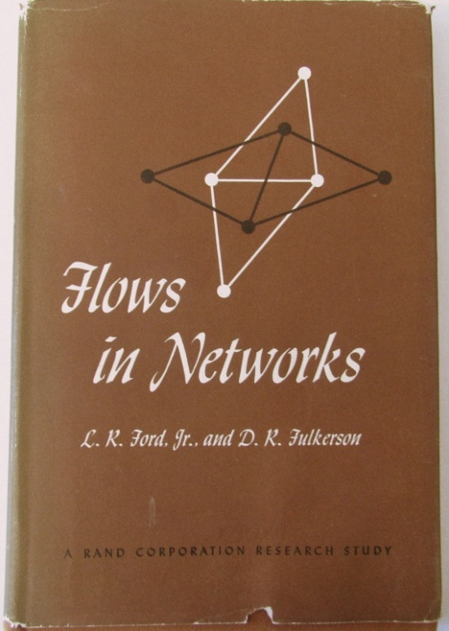
Flows over Time
Flows over time have been studied since [Ford, Fulkerson ’62]
Used for traffic engineering, freight, evacuation planning, etc.

Slide 18
Flows over Time
c₇ , d₇
c₂ , d₂
c₈ , d₈
c₁ , d₁
c₃ , d₃
s
t
c₉ , d₉
c₁₁ , d₁₁
c₆ , d₆
Flow value v
c₄ , d₄
c₁₀ , d₁₀
c₅ , d₅
Total time: ?
What’s the “quickest flow”?
Quickest flow: flow over time which gets flow value v
from s to t in shortest time
[FF ‘62] showed how to compute quickest flow in polynomial time

Slide 19
Selfish Flows over Time
Traffic in networks is uncoordinated
Players pick routes selfishly to minimize travel time

Slide 20
Motivation I & II: Networks
Road traffic
Data networks

Slide 21
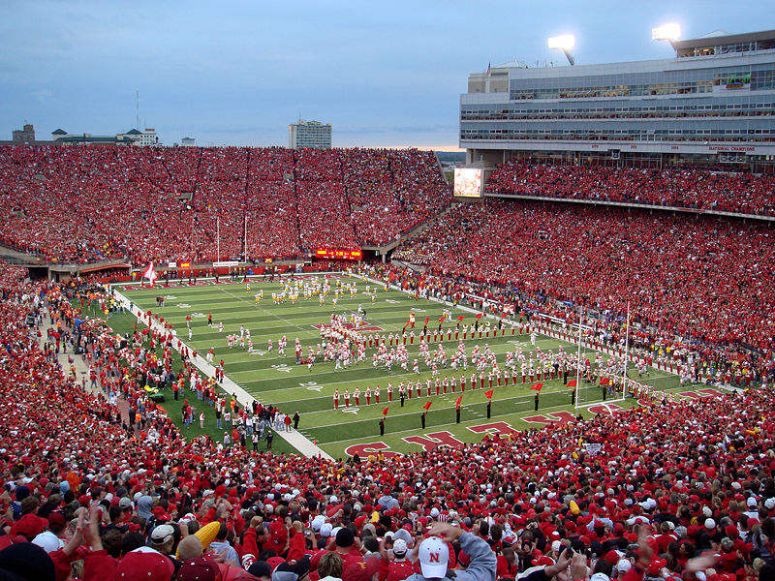
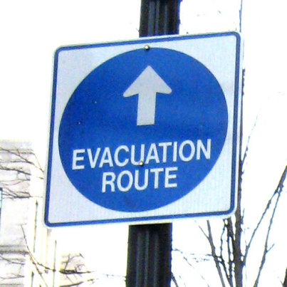
Motivation III : Evacuation
Safe zone

Slide 22
A Queuing Model
s
c = 2, d = 2
c = 1, d = 1
t
But if players are selfish …

Slide 23
A Queuing Model
?
s
c = 2, d = 2
c = 1, d = 1
t
Queue forms here

Slide 24
A Closer Look at Queues
s
c = 2, d = 2
c = 1, d = 1
t
Queue
Queues are formed when inflow exceeds capacity on an edge
Queues are first in, first out (FIFO)
Player’s delay depends on queue as well

Slide 25
A Game-Theoretic Model
Assumptions:
Players are infinitesimal
s
t
flow
at t
time

Slide 26
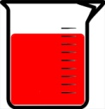
A Game-Theoretic Model
Assumptions:
Players are infinitesimal
s
t
Model:
Players are ordered at s
Each player picks a path from s to t
Minimizes the time it arrives at t
flow
rate
at t
time

Slide 27
Equilibrium
?
t
s
Delay along
a path
depends on
Queues
depend on
Other players
?

Slide 28
Equilibrium
?
?
t
s
Delay along
a path
depends on
Queues
depend on
Other players
?

Slide 29
Equilibrium
!
!
t
s
At equilibrium, every player minimizes its delay w. r. t. others;
thus no player wants to change
Equilibria are stable outcomes

Slide 30
Features of the Model
s
t
Various nice properties, including existence of equilibrium in single-source, single-sink case
[Koch, Skutella ‘09]
our case

Slide 31
So Far…
We’ve seen a game-theoretic model of selfish flows over time, based on queues
s
t
Equilibrium exists in this model
But how bad is equilibrium?

Slide 32
The Price of Anarchy
Price of Anarchy (PoA) =
s
t
Time taken at equilibrium for all flow to reach t
Time taken by quickest flow
So, what is the Price of Anarchy for selfish flows over time?
[KS ‘09]
In static flow games, PoA is essentially unbounded
(Quickest flow minimizes time for flow to reach t)

Slide 33
The Price of Anarchy
Lower bound of e/(e-1) ~ 1.6 [KS ‘09]
Flow rate
at t
Time
s
t

Slide 34
The Price of Anarchy
Lower bound of e/(e-1) ~ 1.6 [KS ‘09]
Flow rate
at t
Time
s
t
i.e., flow rate at t increases to maximum in one step
Upper bounds?

Slide 35
Enforcing a bound on the PoA
We show (to appear in SODA ‘11):
The network administrator can enforce a bound of e/(e-1) on the Price of Anarchy
In a network with reduced capacity, equilibrium takes time
≤ e/(e-1) ~ 1.6 times the minimum in original graph

Slide 36
Enforcing a bound on the PoA
In a network with reduced capacity, equilibrium takes time
≤ e/(e-1) ~ 1.6 times the minimum in original graph
1. Modify network so that quickest flow is unchanged
2. Main Lemma: In modified network, the example shown in [KS ’09] has largest PoA = e/(e-1)
Corollary: Equilibrium in modified network takes time ≤ e/(e-1) times the quickest flow

Slide 37
Enforcing a bound on the PoA
In a network with reduced capacity, equilibrium takes time
≤ e/(e-1) ~ 1.6 times the minimum in original graph
1. Modify network so that quickest flow is unchanged
2. Main Lemma: In modified network, the example shown in [KS ’09] has largest PoA = e/(e-1)
Corollary: Equilibrium in modified network takes time ≤ e/(e-1) times the quickest flow

Slide 38
Enforcing a bound on the PoA
1. Modify network so that quickest flow is unchanged
c, d
a. Compute quickest flow in the original network
s
t
b. On every edge, remove capacity in excess of quickest flow
c', d
s
t
([FF ‘62] gave a polynomial-time algorithm for computing quickest flow)

Slide 39
Enforcing a bound on the PoA
2. Main Lemma: In modified network, the example shown in [KS ’09] has largest PoA
Flow rate
at t
Time
s
t
i.e., PoA is largest when flow rate at t increases in one step
(PoA of [KS ‘09] example is e/(e-1) )

Slide 40
Open Questions
1. If we don’t remove excess capacity, can PoA exceed e/(e-1) ?
2. PoA for multiple sources
3. What if players have imperfect information?
4. …
Thanks for listening!

Slide 41
Thanks for listening!

Slide 42
Enforcing a bound on the PoA
In a network with reduced capacity, equilibrium takes time
≤ e/(e-1) ~ 1.6 times the minimum in original graph
1. Modify network so that quickest flow is unchanged
2. Main Lemma: In modified network, the example shown in [KS ’09] has largest PoA = e/(e-1)
Corollary: Equilibrium in modified network takes time ≤ e/(e-1) times the quickest flow

Slide 43
Enforcing a bound on the PoA
We show: the network administrator can enforce a bound of e/(e-1) on the Price of Anarchy
1. Modify network so that quickest flow is unchanged
2. Main Lemma: In modified network, the example shown in [KS ’09] has largest PoA = e/(e-1)
- In modified network, equilibrium takes at most e/(e-1) of the time taken by quickest flow

Slide 44
A Closer Look at Queues - II
s
t
Queues are time-varying
Players should anticipate queue at an edge in the future, i.e., at time when player reaches the edge

Slide 45
A Simple Example
Capacity c_{e} bounds rate of outflow; rate of inflow is unbounded
Excess flow forms a queue on the edge

Slide 46
A Closer Look at Queues - II
s
t

Slide 47
A Closer Look at Queues - II
s
t
We assume that path chosen by each player is known
So each player can calculate queue on an edge at any time

Slide 48
A Closer Look at Queues
s
c = 2, d = 2
c = 1, d = 1
t
Queue
Queues are time-varying
Assume: players know time taken along a path

Slide 49








Price of Anarchy
Central coordination
Distributed usage
vs
Distributed usage of resources leads to inefficiency, e.g.,
slowing down of traffic
overuse of some resources, underuse of others

Slide 50
Price of Anarchy
Central coordination
Distributed usage
vs
For a given objective (e.g., average speed, resource usage)
Price of Anarchy measures worst-case inefficiency
due to distributed usage

Slide 51
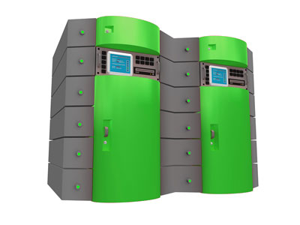


Price of Anarchy
(i)
(ii)
(iii)
For a given objective (e.g., traffic slowdown, resource usage),
Price of Anarchy measures worst-case inefficiency
due to distributed usage

Slide 52
Price of Anarchy
Uses of Price of Anarchy:
Guide design of systems
(Murphy’s Law!)

Slide 53
Flows over Time
Traffic in networks varies with time
Edges have delays
Common models assume static traffic, no delays

Slide 54
The
Price of
Anarchy
(and how to control it)

Slide 55
Enforcing a bound on the PoA
2. Main Lemma: In modified network, the example shown in [KS ’09] has largest PoA
Flow rate
at t
s
t
Time

Slide 56
Enforcing a bound on the PoA
2. Main Lemma: In modified network, the example shown in [KS ’09] has largest PoA
Flow rate
at t
s
t
Time

Slide 57
Equilibrium
?
t
s
Delay along
a path
depends on
Queues
depend on
Other players
?

Slide 58
Equilibrium
?
?
t
s
Delay along
a path
depends on
Queues
depend on
Other players
?

Slide 59
Properties at Equilibrium
Flow rate
at t
c = 1, d = 10
c = 1, d = 1
s
t
Time
c = 3, d = 0
c = 2, d = 0
c = 1, d = 0
At any time there is a quickest-path network (least delay s-t paths)
At equilibrium, players use path in quickest-path network
[Koch, Skutella ‘09]

Slide 60
Properties at Equilibrium
Flow rate
at t
c = 1, d = 10
c = 1, d = 1
s
t
Time
c = 3, d = 0
c = 2, d = 0
c = 1, d = 0
At any time there is a quickest-path network (least delay s-t paths)
At equilibrium, players use path in quickest-path network
[Koch, Skutella ‘09]

Slide 61
Properties at Equilibrium
Flow rate
at t
c = 1, d = 10
c = 1, d = 1
s
t
Time
c = 3, d = 0
c = 2, d = 0
c = 1, d = 0
At any time there is a quickest-path network (least delay s-t paths)
At equilibrium, players use path in quickest-path network
[Koch, Skutella ‘09]

Slide 62
Properties at Equilibrium
Flow rate
at t
c = 1, d = 10
c = 1, d = 1
s
t
Time
c = 3, d = 0
c = 2, d = 0
c = 1, d = 0
At any time there is a quickest-path network (least delay s-t paths)
At equilibrium, players use path in quickest-path network
[Koch, Skutella ‘09]

Slide 63
Properties at Equilibrium
Flow rate
at t
c = 1, d = 10
c = 1, d = 1
s
t
Time
c = 3, d = 0
c = 2, d = 0
c = 1, d = 0
At any time there is a quickest-path network (least delay s-t paths)
At equilibrium, players use path in quickest-path network
[Koch, Skutella ‘09]

Slide 64
Properties at Equilibrium
Flow rate
at t
c = 1, d = 10
c = 1, d = 1
s
t
Time
c = 3, d = 0
c = 2, d = 0
c = 1, d = 0
At any time there is a quickest-path network (least delay s-t paths)
At equilibrium, players use path in quickest-path network
[Koch, Skutella ‘09]

Slide 65
So Far…
s
t
For a given objective,
how well does the system perform,
for uncoordinated traffic routing?
At equilibrium, how quickly does all the flow reach t ?

Slide 66
Static Flows
s
t

Slide 67
Modeling Uncoordinated Traffic
How do we model uncoordinated traffic?

Slide 68
Modeling Uncoordinated Traffic
How do we model uncoordinated traffic?
Direct simulation
flexible
only for small instances
no rigorous analysis

Slide 69
Modeling Uncoordinated Traffic
How do we model uncoordinated traffic?
Direct simulation
Mathematical models
allow rigorous analysis
assume probabilistic traffic
difficult to analyse

Slide 70
Modeling Uncoordinated Traffic
How do we model uncoordinated traffic?
Direct simulation
Mathematical models
Routing games with static flows
- allow rigorous analysis
- capture player “selfishness”
- network flows, game theory
Tight bounds on PoA in this model

Slide 71
Static Flows

Slide 72
Flows over Time

Slide 73
Flows over Time
- Edges have delays
- Flow on an edge varies with time

Slide 74

Motivation IV : Machine Scheduling
Each machine i has a capacity c_{i} and delay d_{i}

Slide 75
Features of the Model
s
t
Continuous time
Preserves FIFO
Queuing model used since ‘70s for studying road traffic

Slide 76
Price of Anarchy
Uses of Price of Anarchy:
Guide design of systems

Slide 77

Price of Anarchy
Uses of Price of Anarchy:
Guide design of systems
Guide design of policies, e.g.,
tollbooths to influence traffic routing

Slide 78
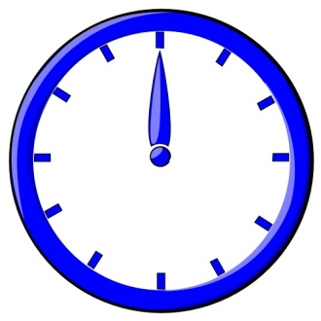
Price of Anarchy
Objective: Time taken by all players to reach destination
A
B

Slide 79
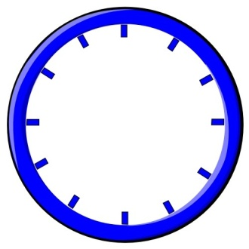


Price of Anarchy
Objective: Time taken by all players to reach destination
A
Uncoordinated
routing
B

Slide 80

System Performance
Objective: Time taken by all players to reach destination
A
Coordinated,
optimal routing
B

Slide 81
System Performance
For a given objective,
how well does the system perform,
for uncoordinated traffic routing?
Objective: Time taken by all players to reach destination
Price
of
Anarchy
Time taken by uncoordinated traffic routing
=
Time taken by optimal routing
we will refine this later

